Slide 1
Understanding Alloy Steel Composition-Property Relationships Using Machine Learning
Raymond Wang, Yangdongling Liu
DATA_SCI 423 | Final Project
Northwestern University

Slide 2
Motivation
e.g. AISI 3140 steel (97.1% Fe, 1.1% Ni, …)
Predict?
Computational models (e.g. FEM) are typically intensive in numerical operations
Could data-driven machine learning models help?
Notes:
Wang:

Slide 3
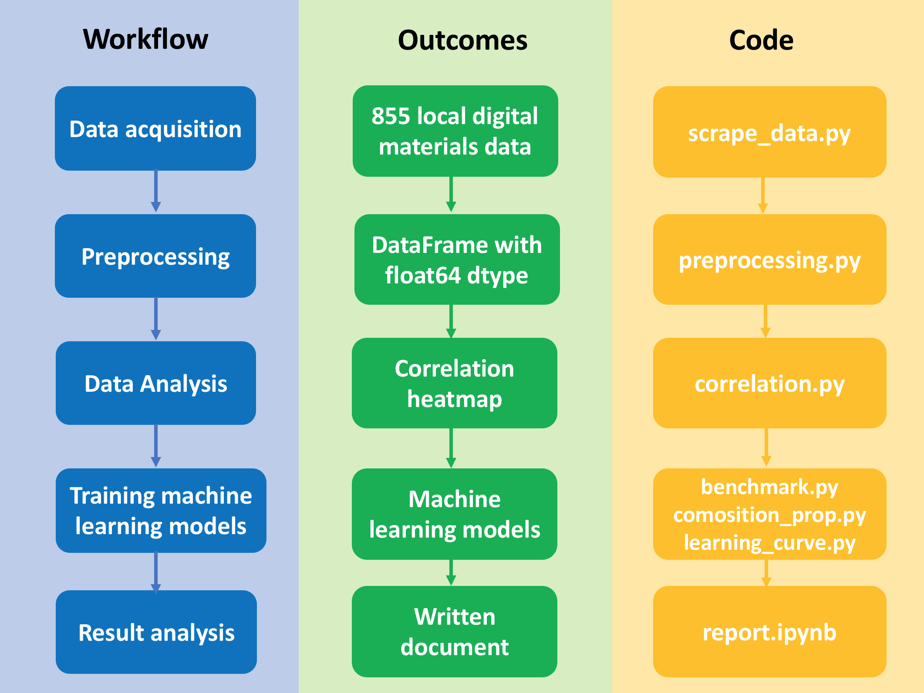
Project Overview
Notes:
Wang:

Slide 4

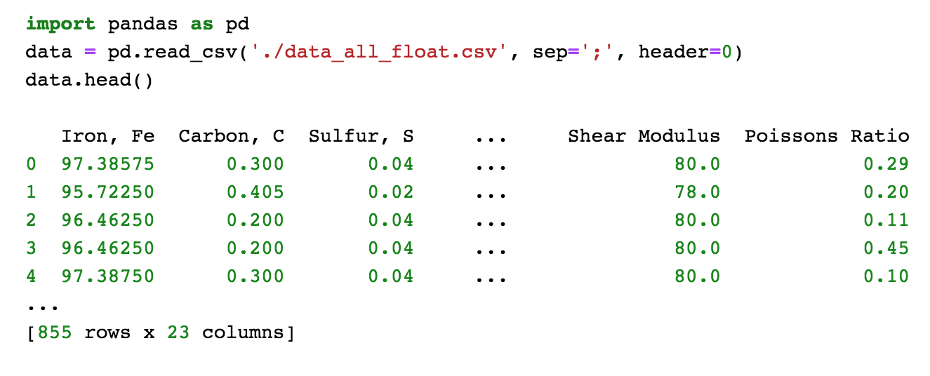
Data Acquisition and Preprocessing
855 Instances
13 Physical properties
Thermal conductivity
Specific heat capacity
Hardness
Electrical resistivity
Elongation at break
Bulk modulus
Modulus of elasticity
Shear modulus
Poisson ratio
Tensile strength at yield
Ultimate tensile strength
10 Features (% weight of element)
Carbon, C
Sulfur, S
Silicon, Si
Phosphorous, P
Manganese, Mn
Chromium, Cr
Nickel, Ni
Molybdenum, Mo
Copper, Cu
Notes:
Wang:

Slide 5
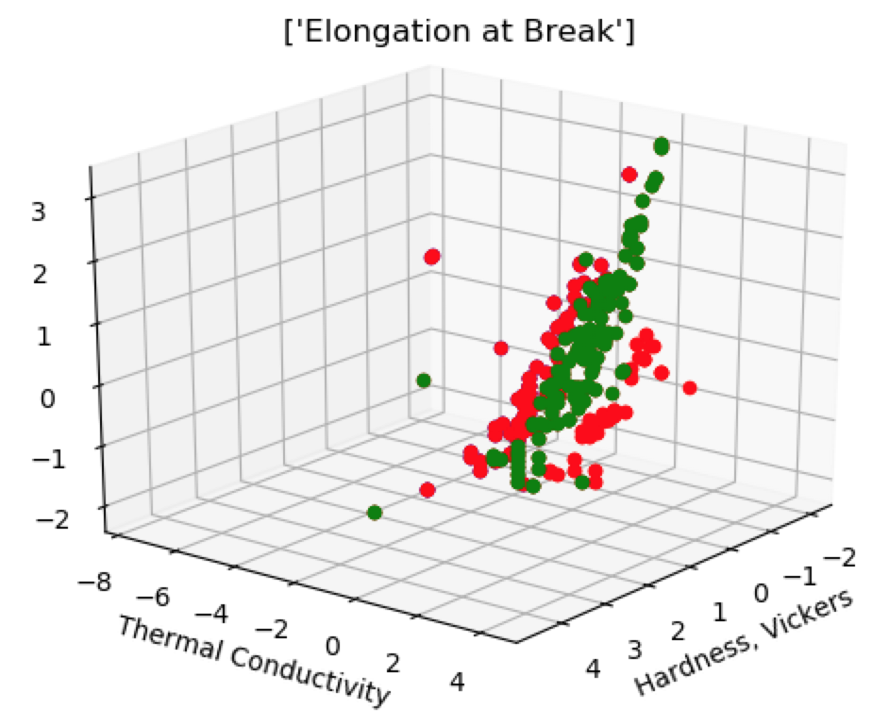
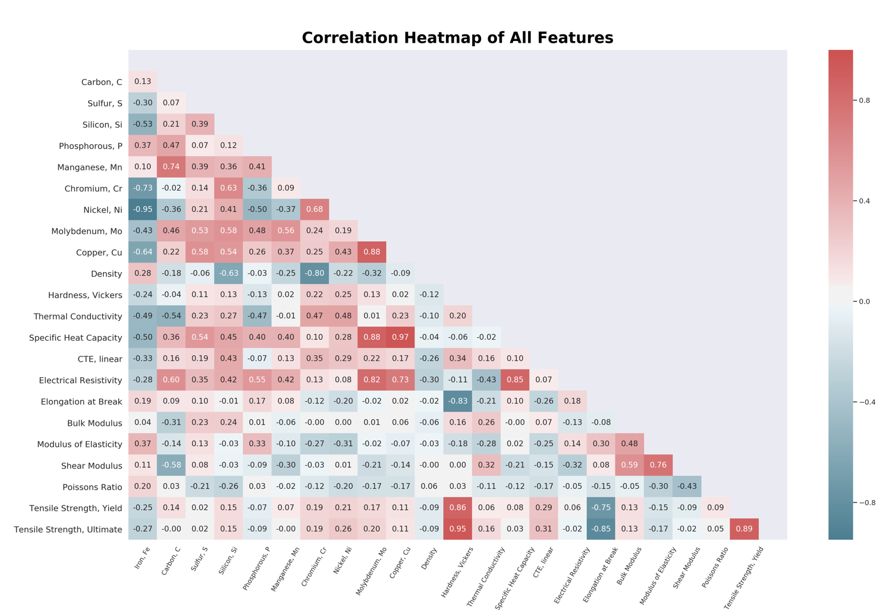
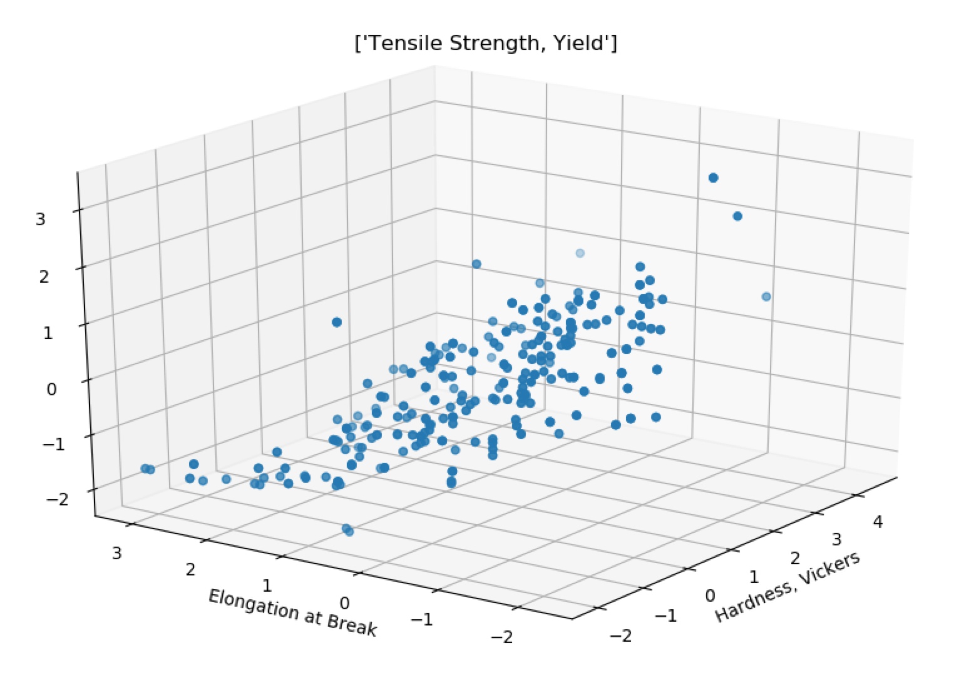
Data Analysis
Visualizing selected data
Correlation Heatmap
Qualitative relationship between composition and properties
Notes:
Wang:

Slide 6
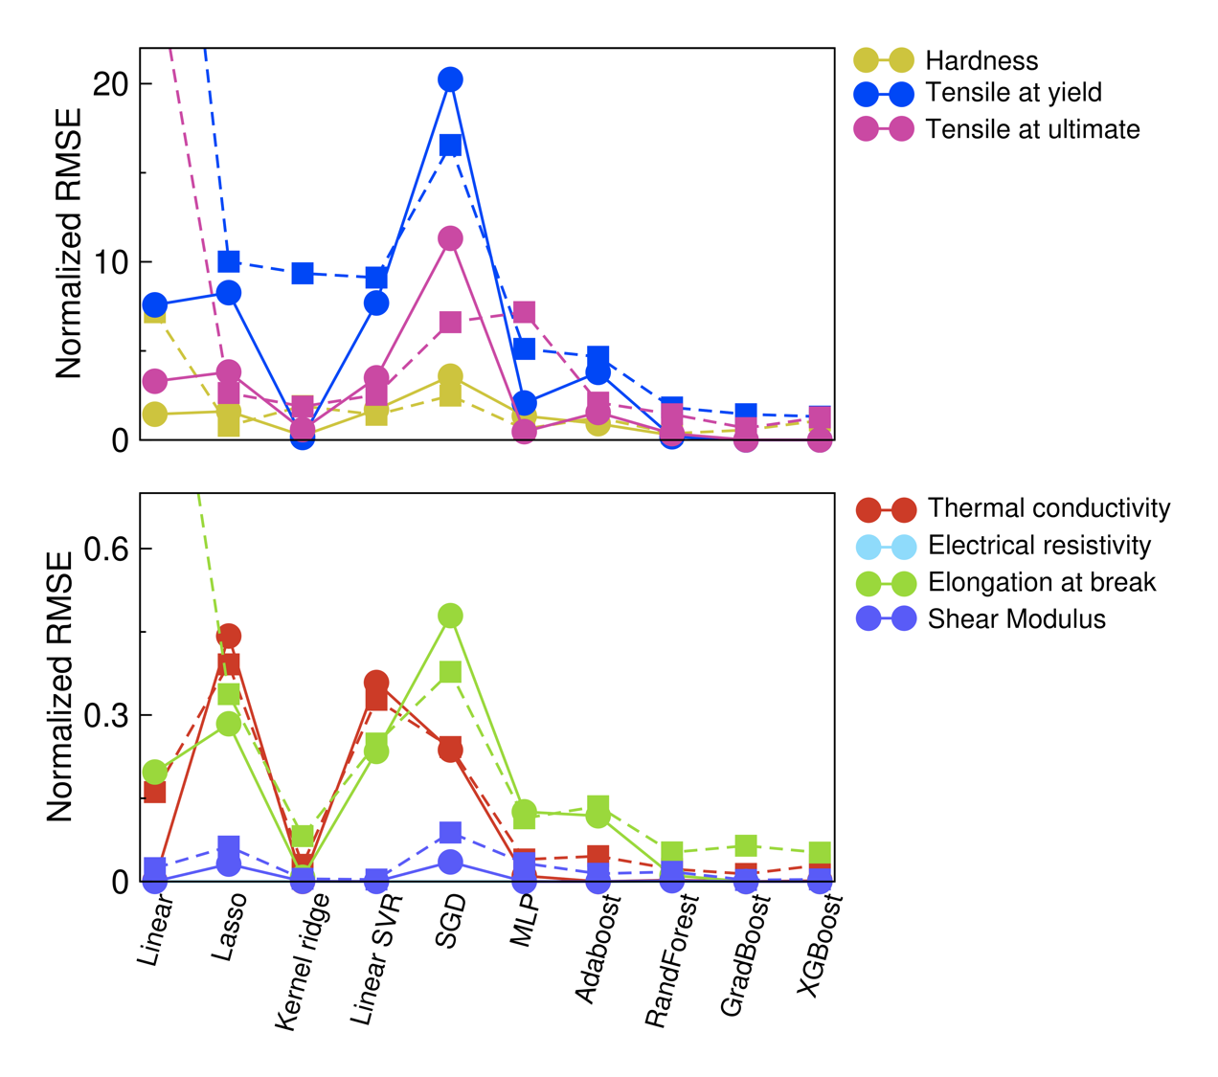
Machine Learning Model Performance
Model performance
Machine learning algorithms benchmarked:
Training
Testing
Linear Regression
Least-Angle Regression with Lasso
Kernel Ridge
Linear Support Vector Regression
Stochastic Gradient Descent Regression
Multi-layer Perceptron Regression
AdaBoost Regression
Random Forest Regression
Gradient Boosting Regression
Extreme Gradient Boosting (XGBoost)
Hyper-parameter tuning with grid search
5-fold cross-validation
(75% training, 25% testing)
XGBoost generally outperforms others
Notes:
Wang:

Slide 7
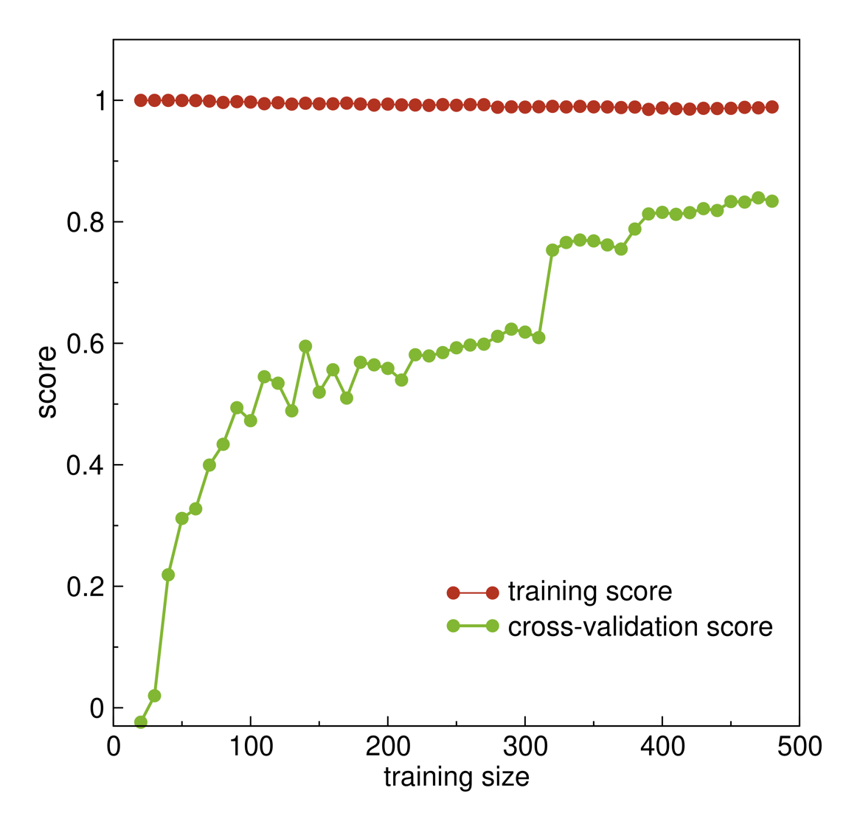
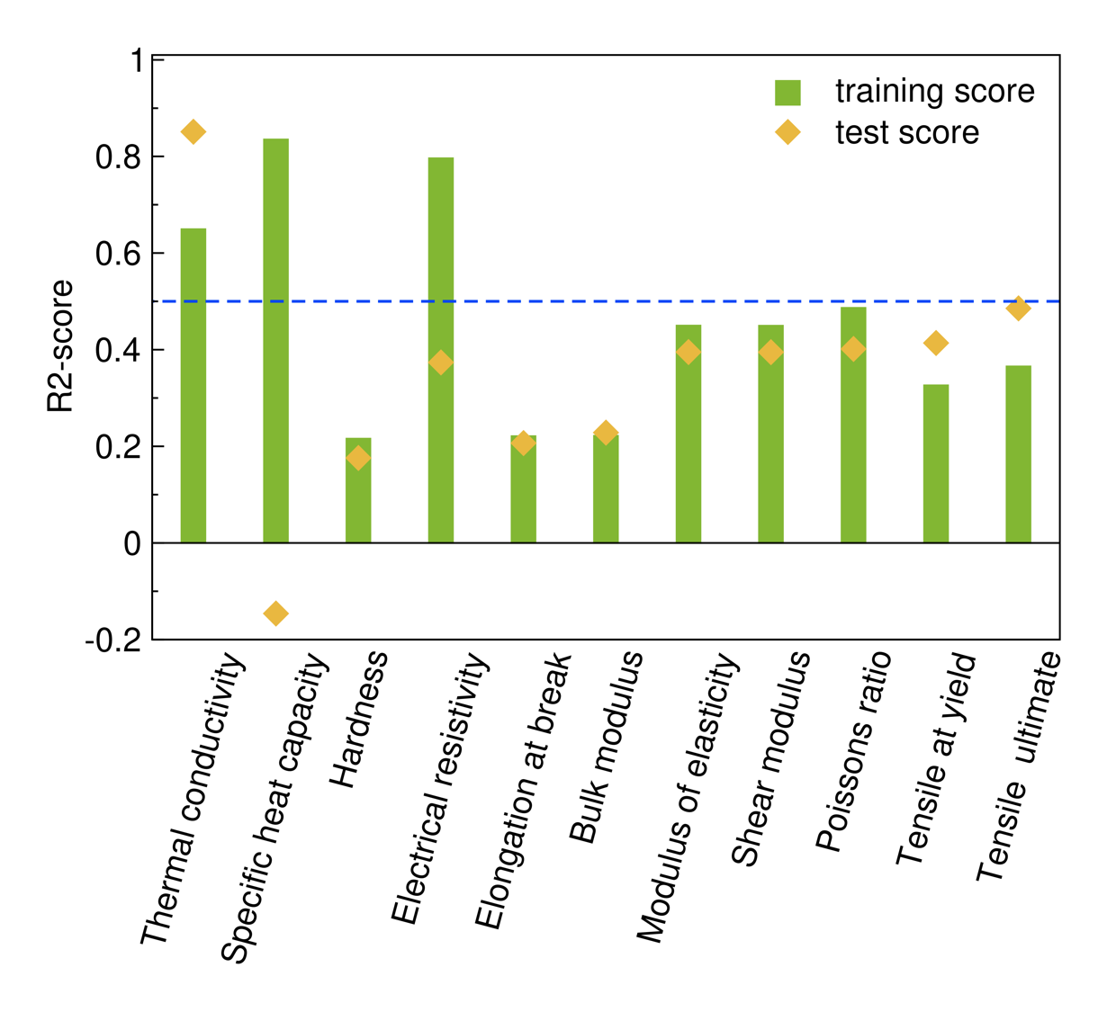
Learning Thermal Properties with XGBoost
Only use elemental composition as features
Learning curve of thermal conductivity
Over-fitting and under-fitting observed
Having more data improves model performance
Notes:
Wang:

Slide 8
Conclusions
Machine learning models provide quantitative descriptions of alloy steel composition-property relationships
XGBoost outperformed the other machine learning algorithms, and is particularly good at thermal conductivity prediction
Having more training data further improves model performance
Thank you!
Notes:
Wang:

